Slide 1
Vehicle Connectivity Innovation Challenge

Slide 2
Customer Problem Statement
A problem statement is a short, clear explanation of an issue or challenge that sums up what you want to change.
When leaving your home or store with your hands full. It’s difficult to open to trunk. What if the vehicle could sense when you arrive and open the lift/tailgate for you?
Example

Slide 3
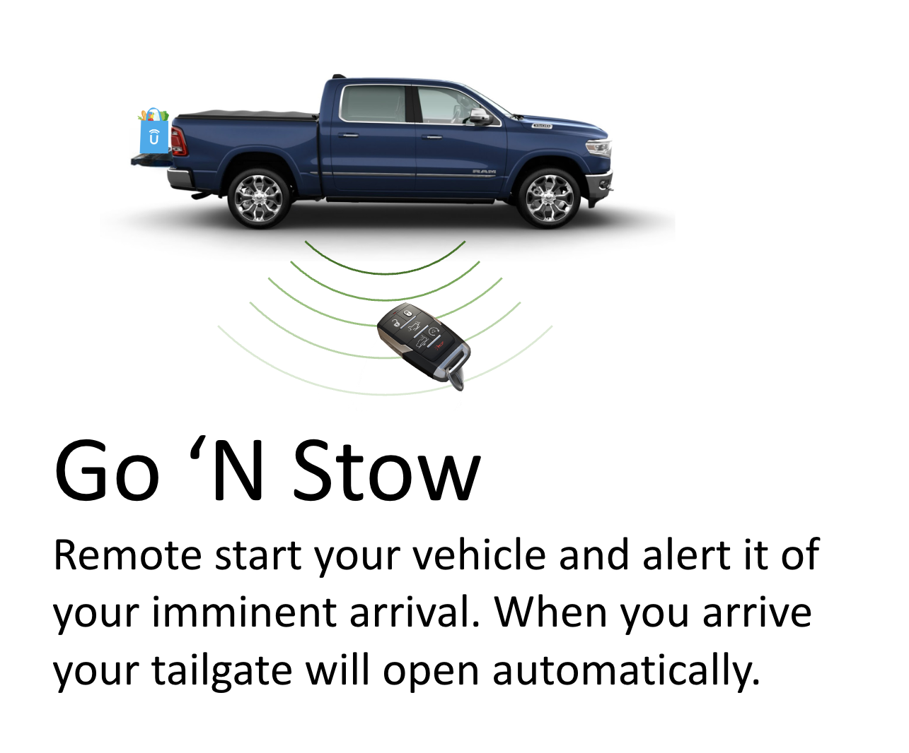
Feature Concept
Sequence Name: GO_N_STOW
Improved Experience
Increased retention
Nothing else like it on the market
100% of people with their hands full have a hard time opening their vehicle doors*
Example

Slide 4
Customer Problem Statement
A problem statement is a short, clear explanation of an issue or challenge that sums up what you want to change.
Fill this out

Slide 5
Feature Concept
Sequence Name:
This is the slide you will present

